Slide 1
TDI: Julia
Functions in Julia
William Mui

Slide 2
Function

Slide 3
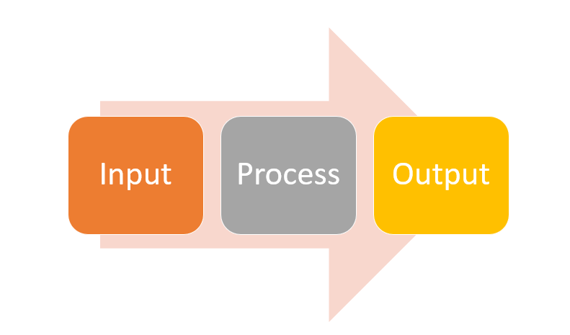
Function
Consider as “sub-program” in a program
Formal definition: “named sequence of statements that performs a computation”
Follows the IPO model
Steps
Several inputs
Do some calculations
Returns(output) the value

Slide 4
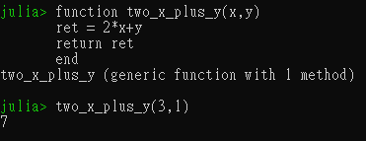
Define a function
Use the keyword “function”
Follows with the name and input arguments
Statements
Finish the definition with keywords “end”

Slide 5
Example
Purpose: Define the function to calculate 2x+y
The name of function is two_x_plus_y
Two arguments: x and y
Calculate 2x+y and store to ret
Return the value of ret
Finish the definition

Slide 6

Alternative method to define a function
Mathematical function style
Suitable for simple function
[function name] ( [arguments] ) = [expression]
Example(the function is the same):

Slide 7
Use(Call) the function
Call the function with name and input values
For example, if we need to calculate 2(3)+1
3 and 1 are the "parameters"

Slide 8
Argument types and Overloading

Slide 9
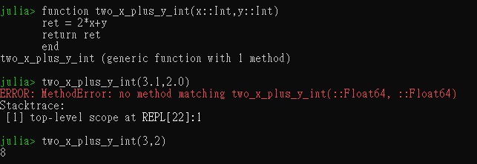
Argument types
Restrict the function only work on specific types
By :: Operator
Error if the type is not match

Slide 10
Function overloading
Define two functions with the same name
But doing different things
Depends on input arguments

Slide 11
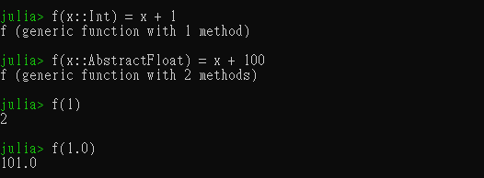
Example
If the input is Int -> return x + 1
If the input is float -> return x+100

Slide 12
Scope of variable

Slide 13
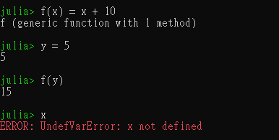
Scope of variable
Variable inside a function are “local variable”
Alternative concept called global variable. Not suggested to use.
It only exists inside the function.
Example:

Slide 14
Built-in Functions

Slide 15
Built-in Functions
Written by Julia developers
Provide basic functionality(e.g. print, file...)
Not suggest to re-define

Slide 16
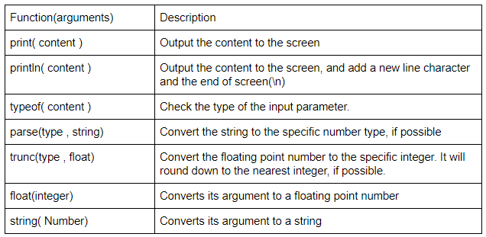
Built-in Functions

Slide 17
Why we need function

Slide 18
Reason
Code reuse
Easier to debug
Optimization
Readability

